Slide 1
Searching and Sorting
Searching in Arrays
Linear Search
Binary Search
Sorting Arrays
Selection Sort
Insertion Sort
Bubble Sort
Quick Sort
Java Standard Library – “java.util.Arrays”
Notes:
Time: 5
- Java uses Dual Pivot Quicksort algorithm

Slide 2
Linear Search
Item desired is our Key
Iterate Linearly until the Key is found
Return Index or -1
Exercise:
Find Largest Integer in an Integer Array
Notes:
Time: 15

Slide 3
Binary Search
Array Must be Sorted
Algorithm
Divide the Array into 2 Partitions
If Middle Item is:
Equal to Key, return its Index
Less than Key, search in Left Partition
Greater than Key, search in Right Partition
Recursive Method
Notes:
Time: 15

Slide 4
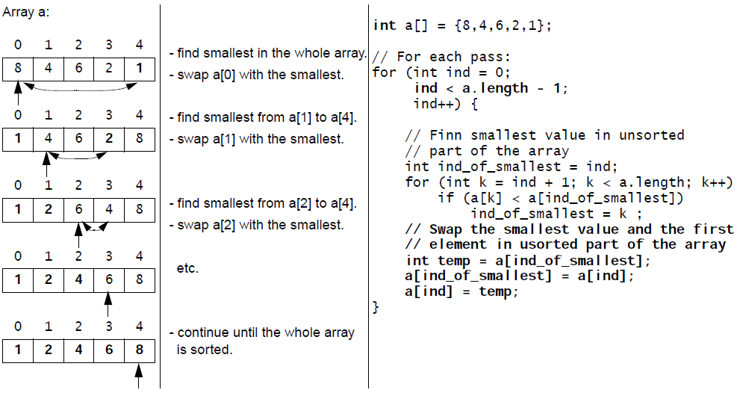
Selection Sort
Select the Smallest Element
Notes:
Time: 15

Slide 5
Selection Sort
Notes:
Time: 5

Slide 6
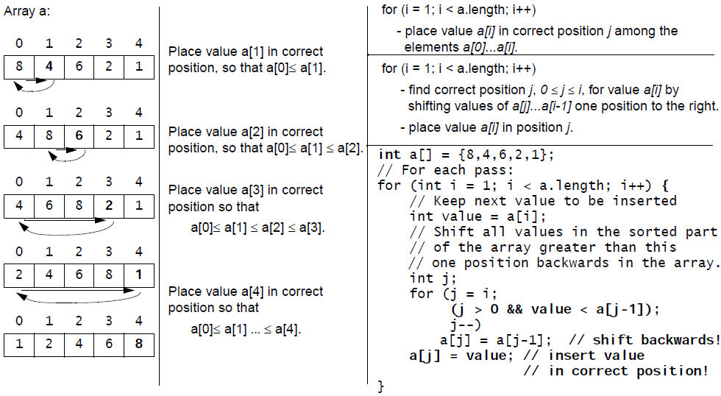
Insertion Sort
Insert in Correct Location
Notes:
Time: 15

Slide 7
Insertion Sort
Notes:
Time: 5

Slide 8
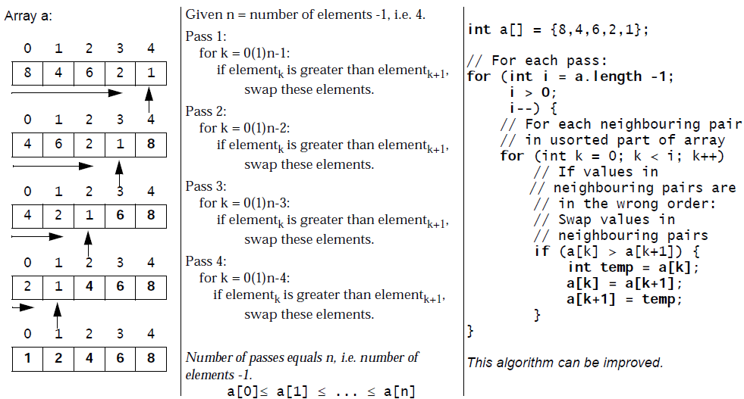
Bubble Sort
Keep Swapping Neighbours
Largest value finds its place in each Pass
Notes:
Time: 15

Slide 9
Bubble Sort
Notes:
Time: 5

Slide 10
Java Standard Library
Quick Sort
Arrays.sort(<array>)
Notes:
Estimated Time: 1h 50m

